Slide 1


Lithium
Loop
Net Zero Hackathon

Slide 2

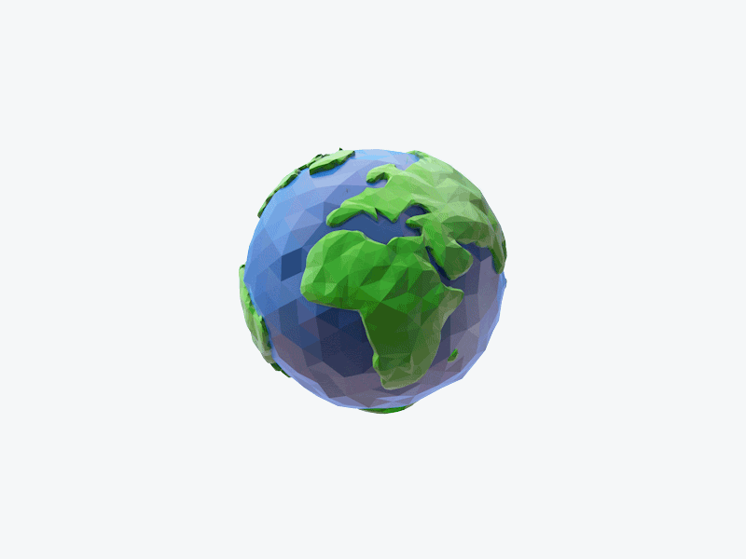

Resources
Energy

Slide 3
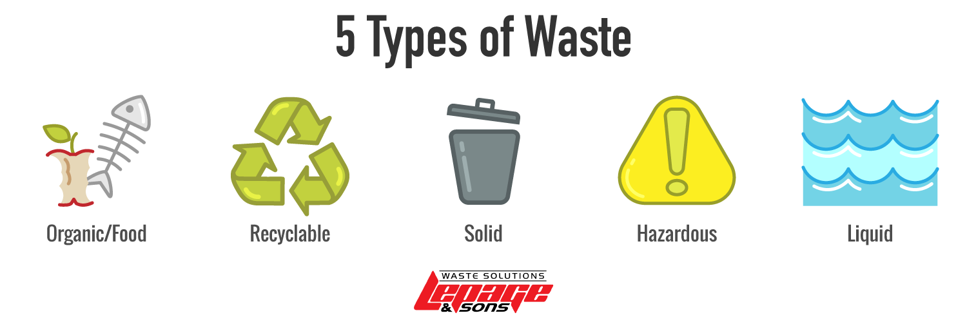
5 Types of Waste

Slide 4
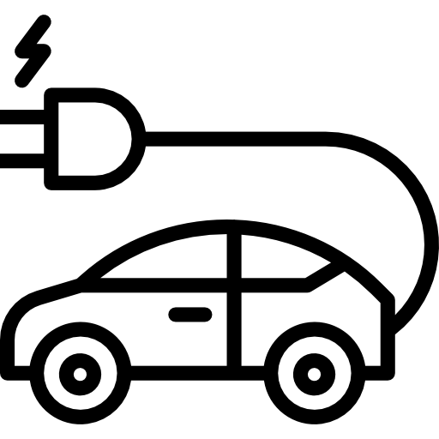
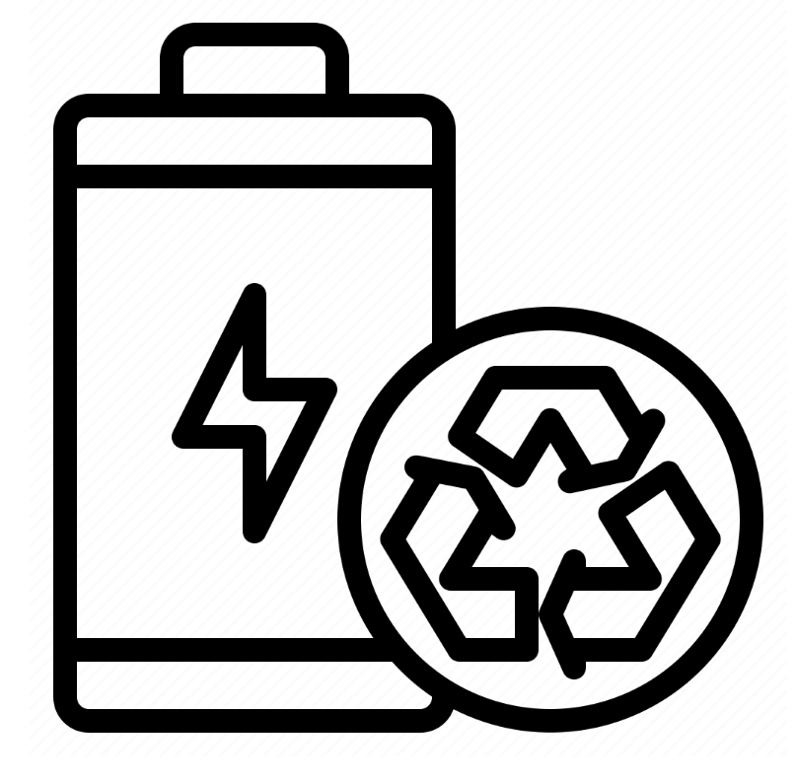
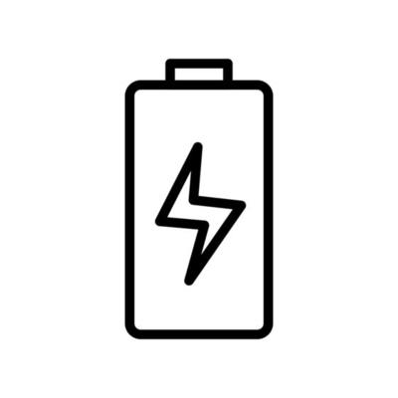

Battery

Slide 5
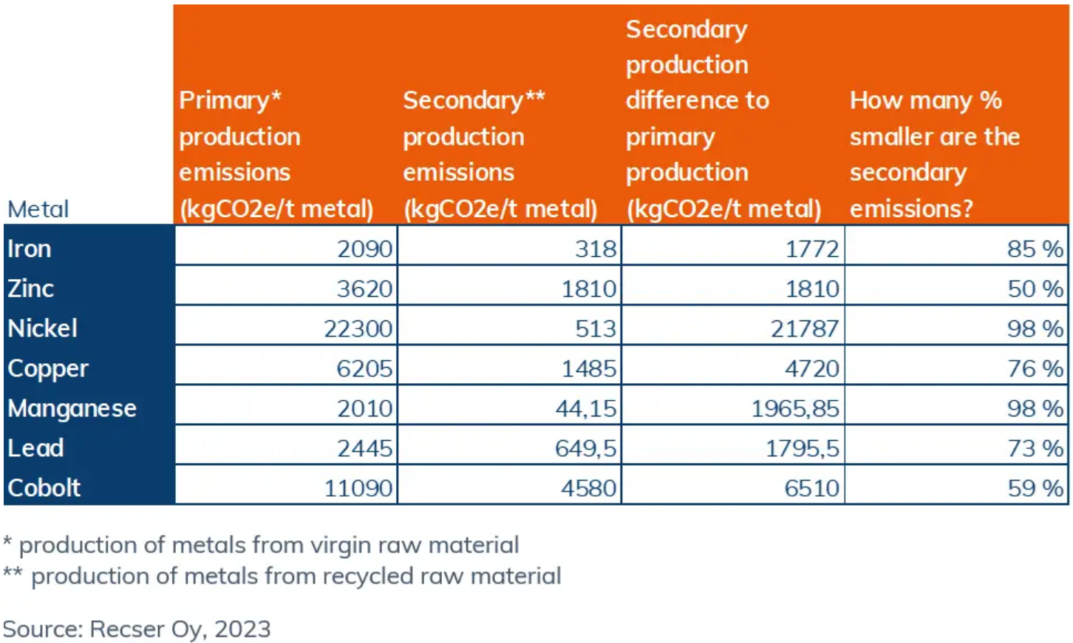

Slide 6
Project
1. Easy to Use
2. Benefit of Customer & Company
3. Sustainable Develop

Slide 7

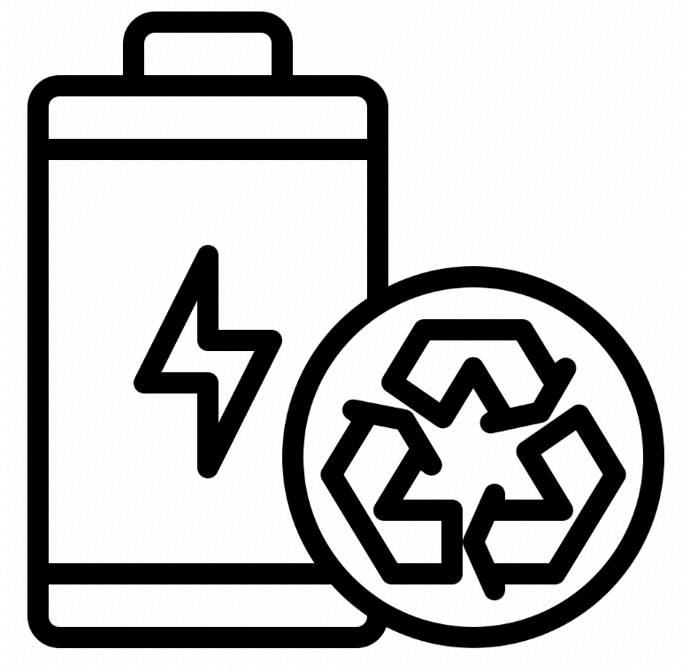



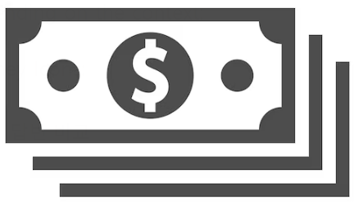
Project

Slide 8
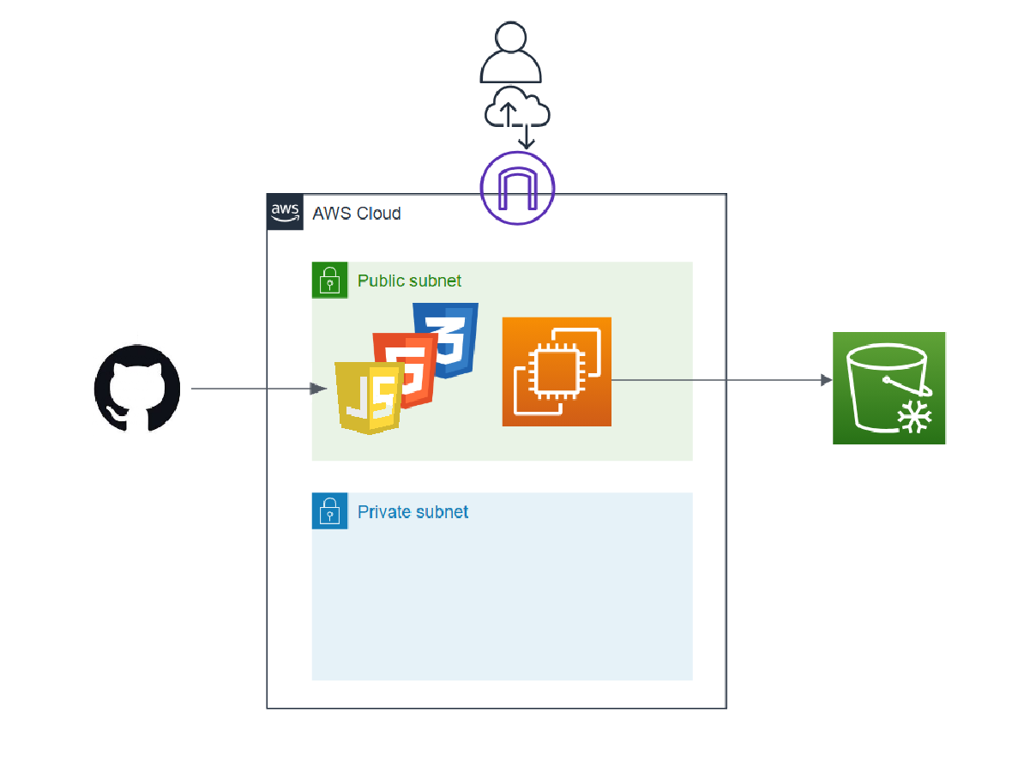

Architecture

Slide 9
Simulation
http://CMU-Project.ac.kr

Slide 10
Team Members
Jun
Eric
Project Manager
System Architecture
Kyle
Sin
UI/UX Developer
System Developer
Saran
Desinger & Researcher

Slide 11
THANK YOU
Lithium Loop
Jun
Eric
Kyle
Sin
Saran
Research :
https://celltech-group.com/press/the-effects-of-battery-recycling-on-co2-emissions/
https://www.linkedin.com/pulse/5-rate-other-untruths-battery-recycling-hans-eric-melin-m5lde
https://www.reportlinker.com/market-report/Recycling/8162/
https://www.poscofuturem.com/pr/view.do?num=728
https://www.bangkokpost.com/thailand/pr/2763114/pioneering-battery-recycling-initiative-transforms-waste-into-value

